Slide 1
ARAS Security A/S
Way ahead… and just around the corner

Slide 2

Complete supplier of security solutions
High quality products
Demonstration
Counseling & evaluation
Development
Specialized knowledge
Education
Project guidance
Support

Slide 3

Combined and integrated system
Access Control
Video Surveillance
Burglar Alarm
Climate Control
Building Management
Fire Alarm
…………

Slide 4
Get what you need – scale up later
NOX Corporate
The complete system.
Open for the full suite of NOX software and hardware products.
3x RS485 BUS
NOXONE
Designed for small and medium sized locations.
1x RS485 BUS
Notes:
Nej

Slide 5
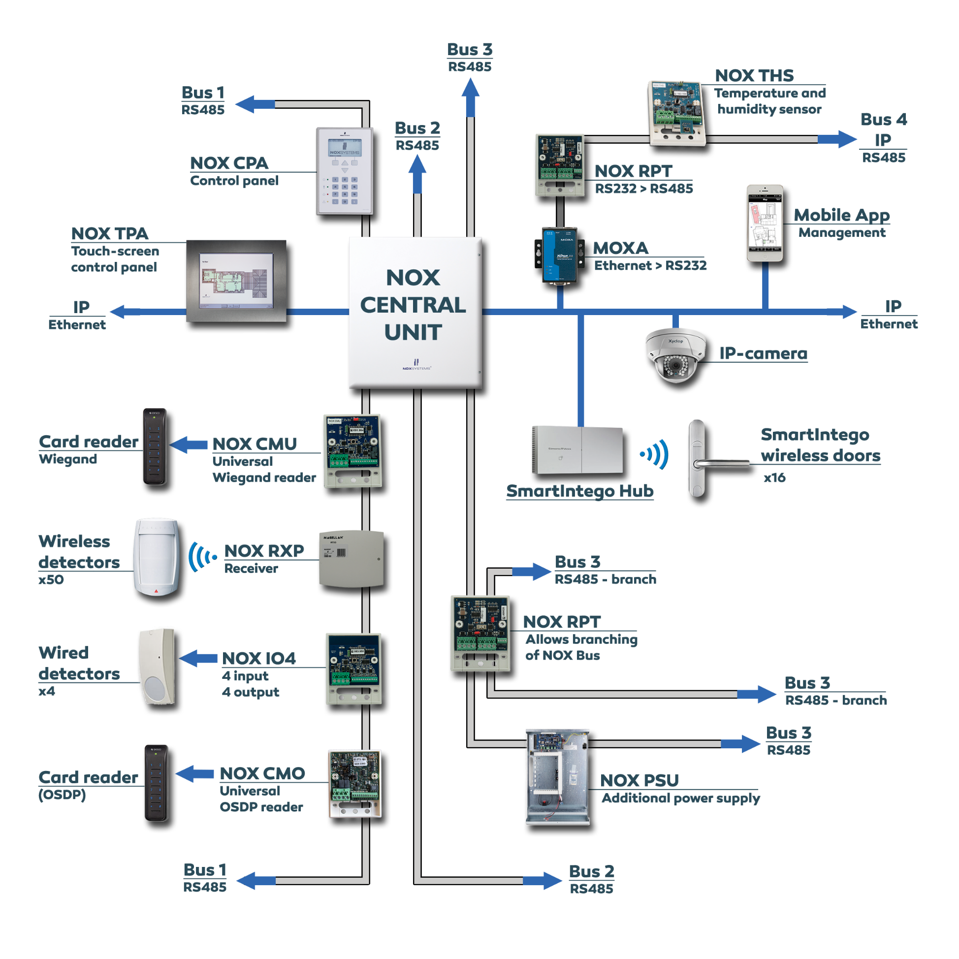
NOX Corporate
Flexible setup with 3 physical NOX busses (two-way)
>2000 inputs (e.g., detectors) + 75 wired door modules per central unit
Wireless doors (Online/Offline) with SmartIntego
Wireless detectors and alarms via Paradox receivers
Core combination of Access Control and Burglar alarm
Open for secure integrations to everything open

Slide 6
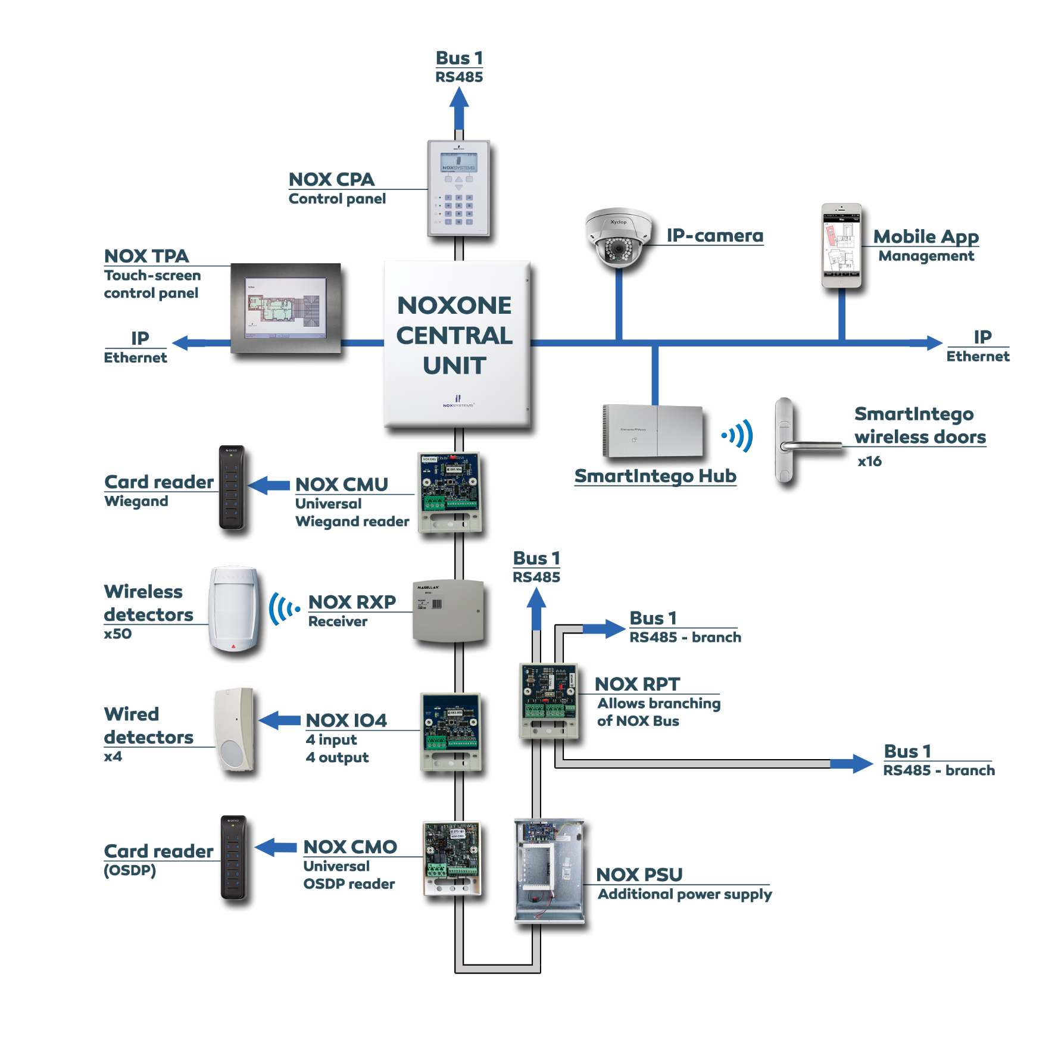
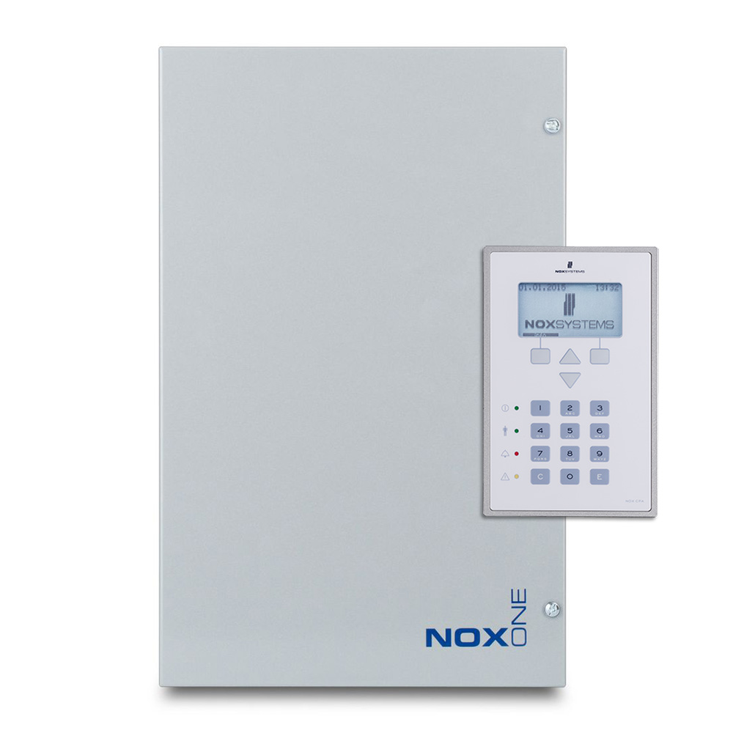
NOXONE
NOXONE central unit has 1 physical NOX bus (two-way)
Notes:
nej

Slide 7
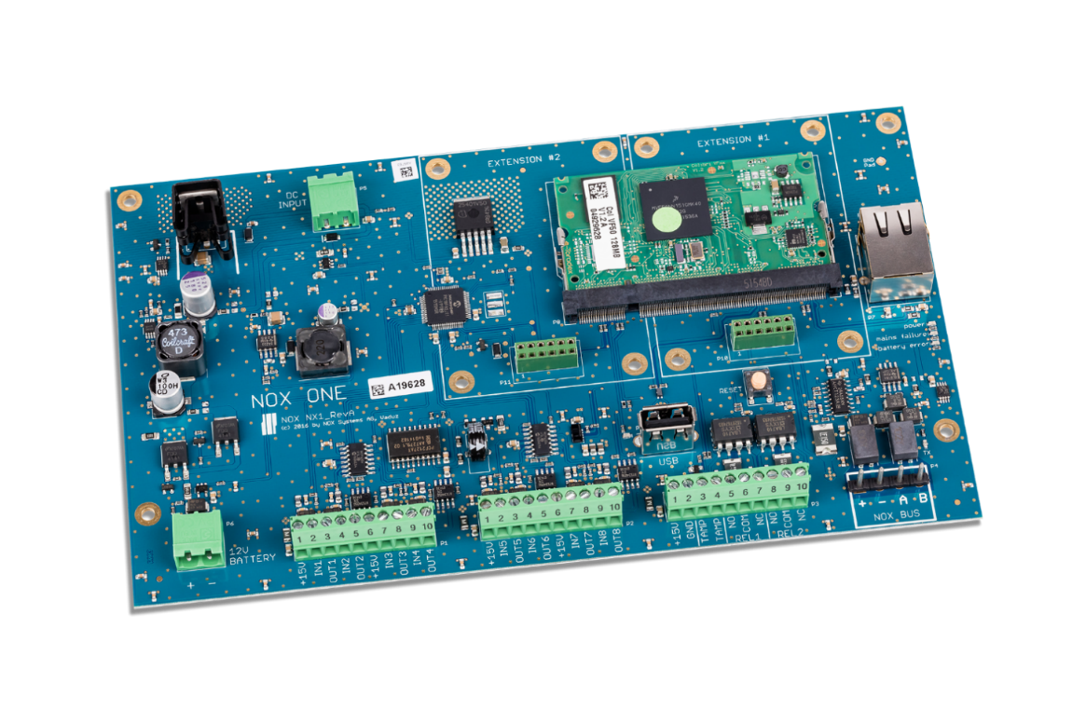
Modules on the bus
Easy service and replacement - Every module contains a unique factory defined address.
Flexibility is in focus with NOX
You adapt the system with modules, based on the functionality you need.
Secure - Data is transmitted to the central unit via the NOX bus (RS485)
All modules can be placed everywhere on the NOX bus
– both access and alarm modules
Flexibility –Find and choose third party technology on the global market.
Notes:
nej

Slide 8
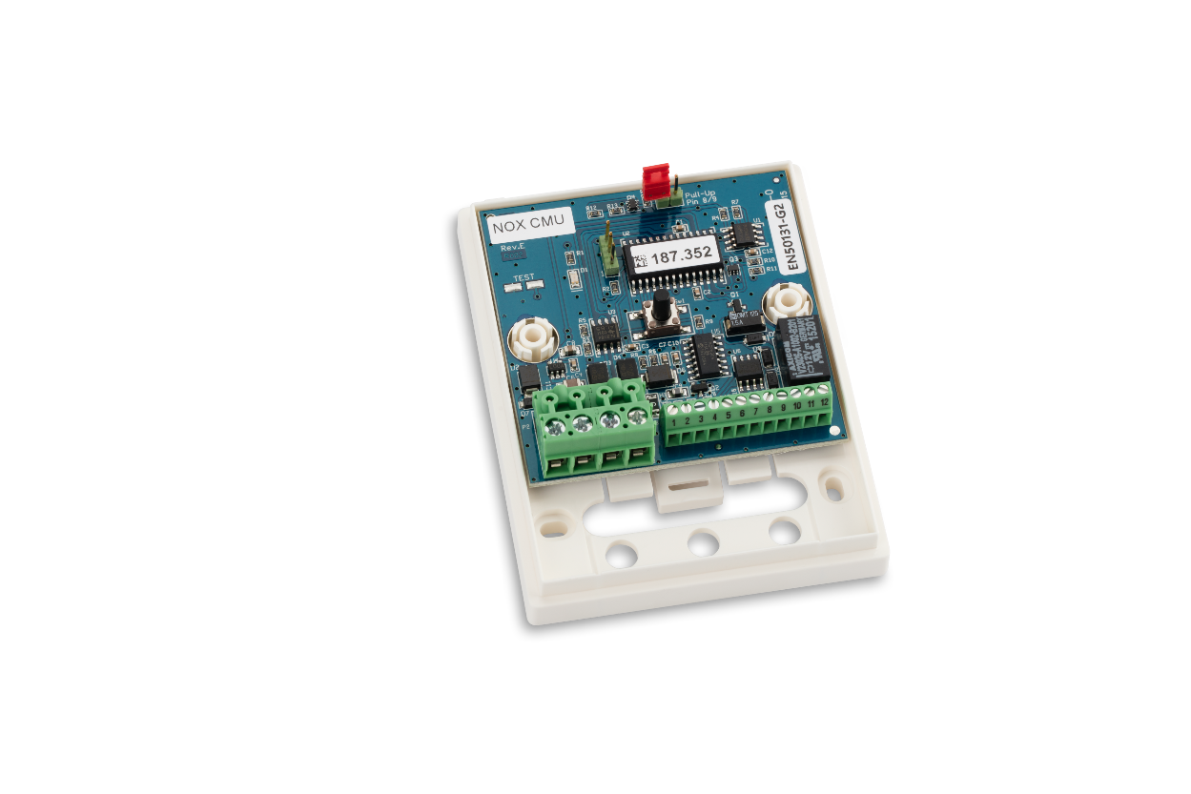
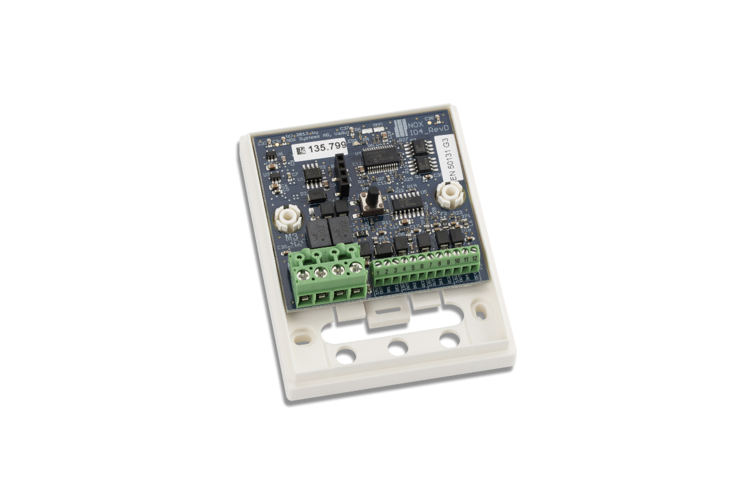
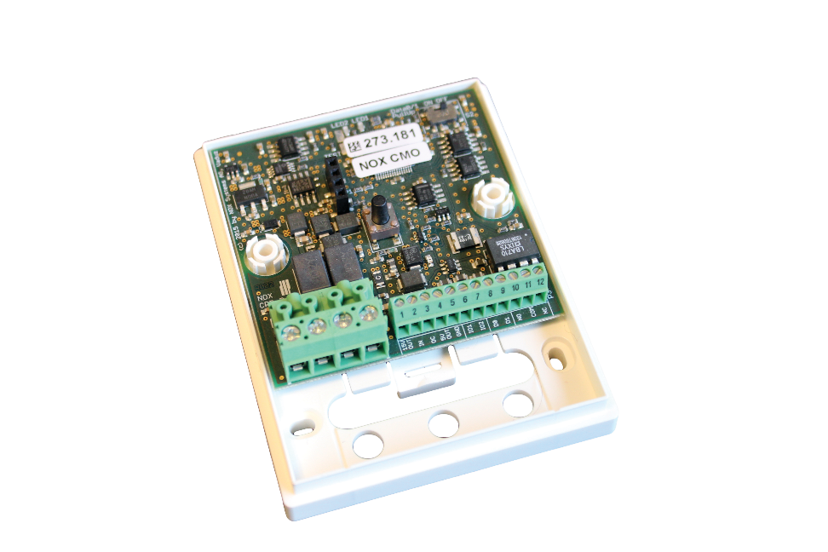
Modules
NOX CMU
NOX CMO
NOX IO4
• Door module
• Card Readers with Wiegand interface
• Programmable input/output/Relay
• Door module (In-and-out)
• Card Readers with OSDP interface
• Programmable input/output/Relay
• Connection of detectors
• Universal I/O4- module
Notes:
Nej

Slide 9
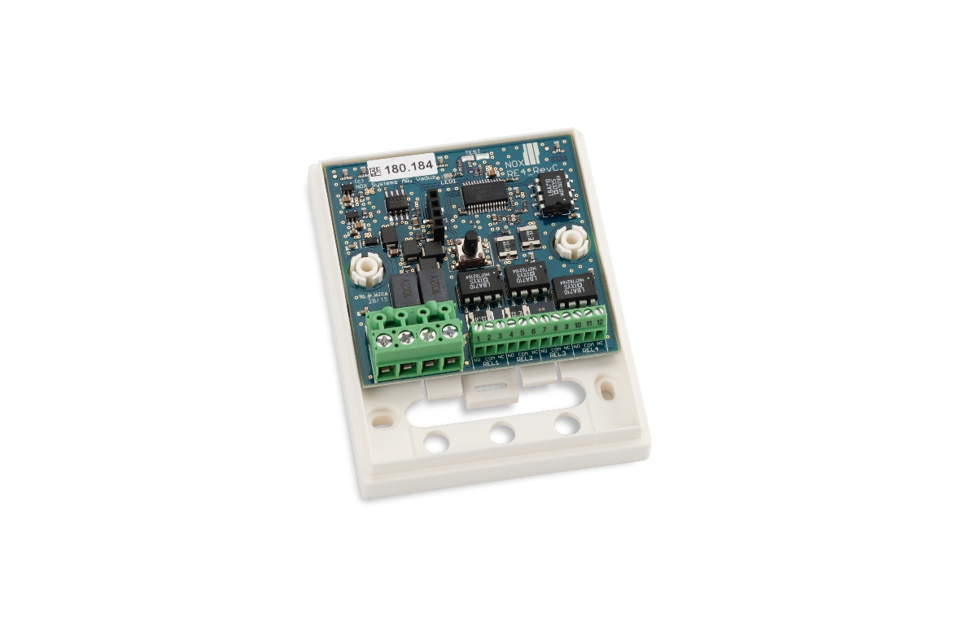
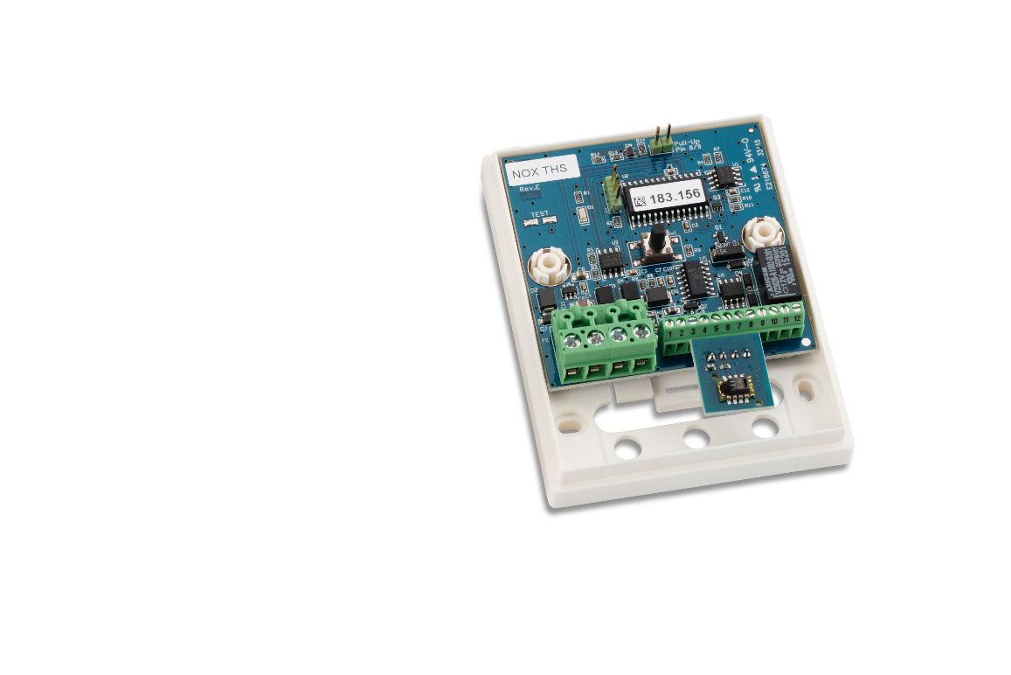
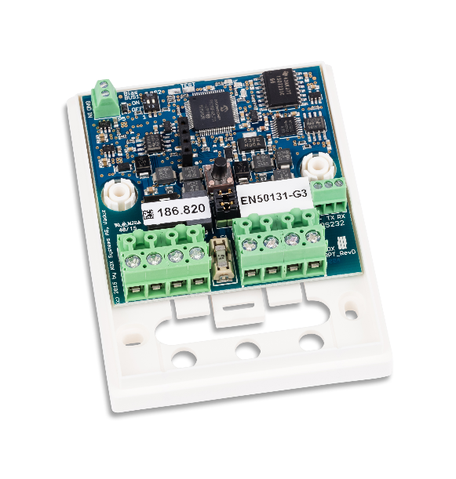
Modules
NOX RPT
NOX RE4
NOX THSi
• Allows extra 72 modules
• Branch off NOX bus
• Relay based signaling
• Elevator control
• Sirens/Horns
• Temperature and humidity measurement
• External sensor can be added
• Relay (e.g., Controlling ventilator)
Notes:
Nej

Slide 10
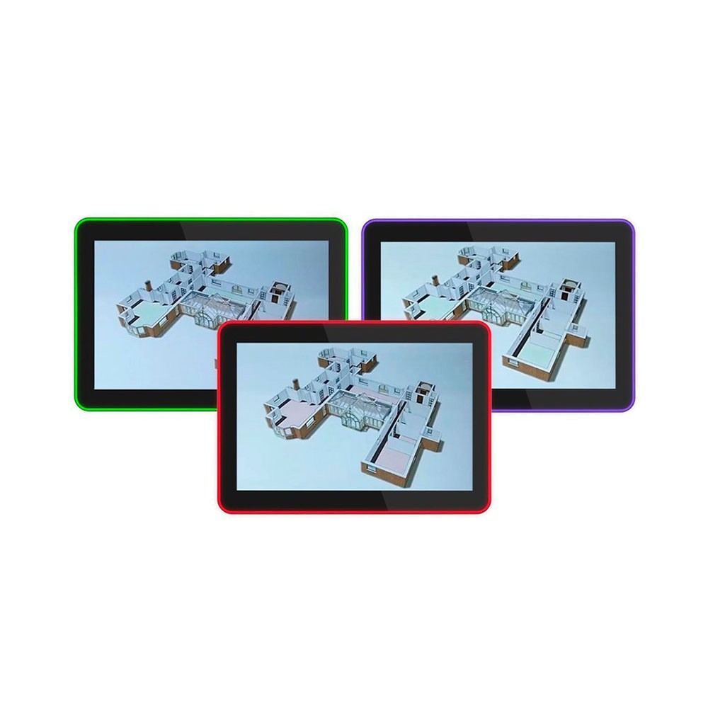
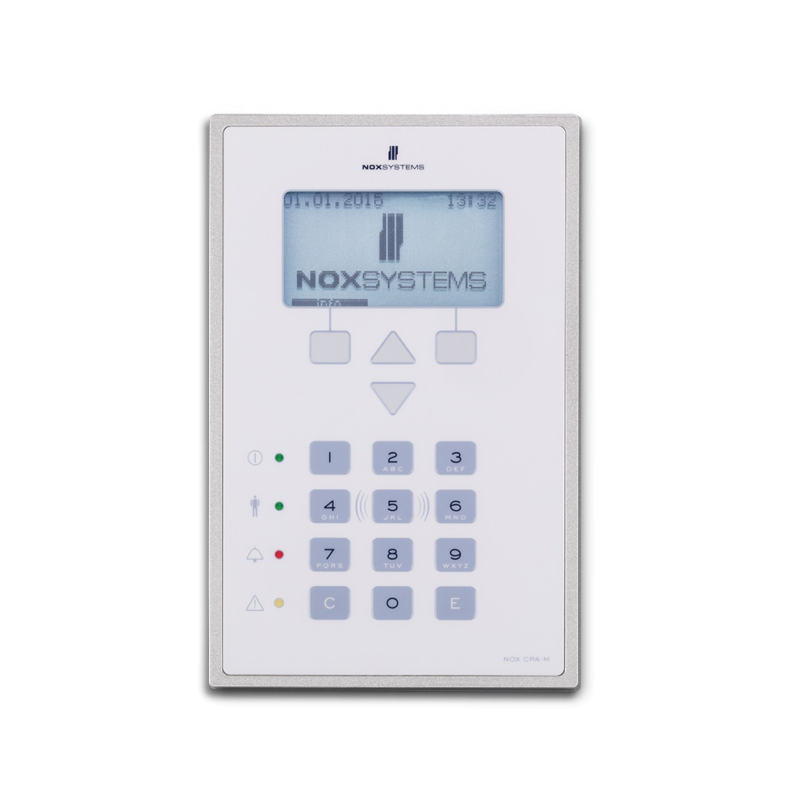
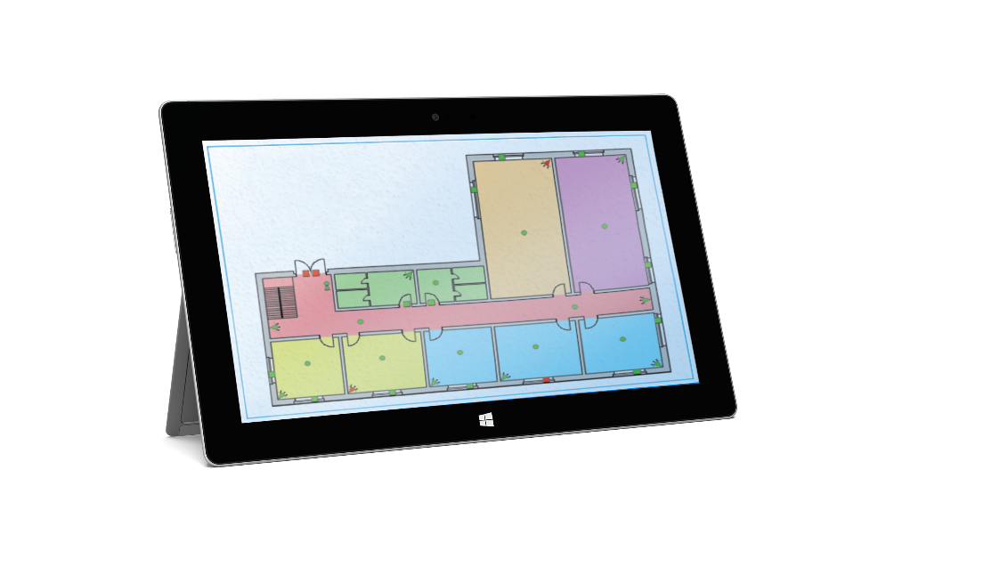
Flexible Control
Touch Screen
NOX CPA
Windows
• 10,1” Touch tablet
• Control areas, users, logs and alarms
• Map and floorplans
• LED bar with customizable functions
• Control panel with display
• Optional card reader
• Control areas, users, logs and alarms
• Computer / windows tablet
• Map and floorplans
• Control areas, users, logs and alarms

Slide 11
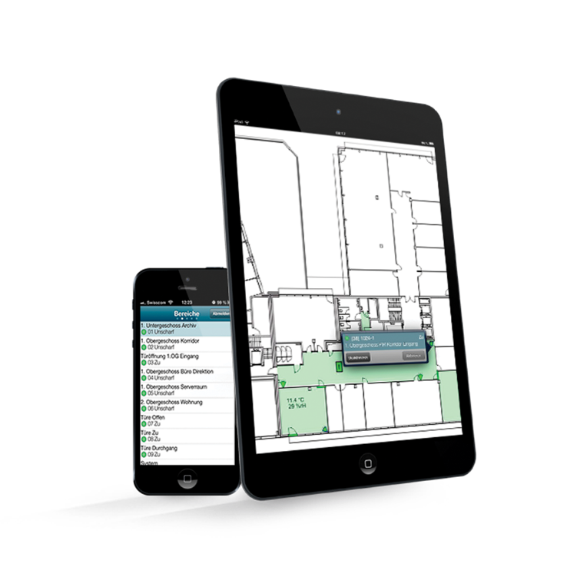
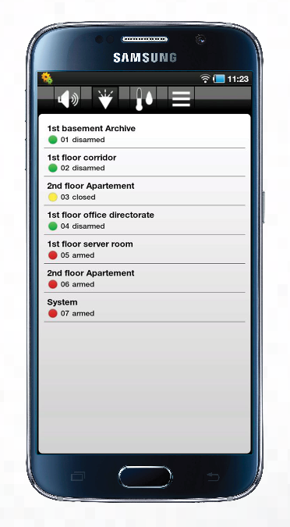
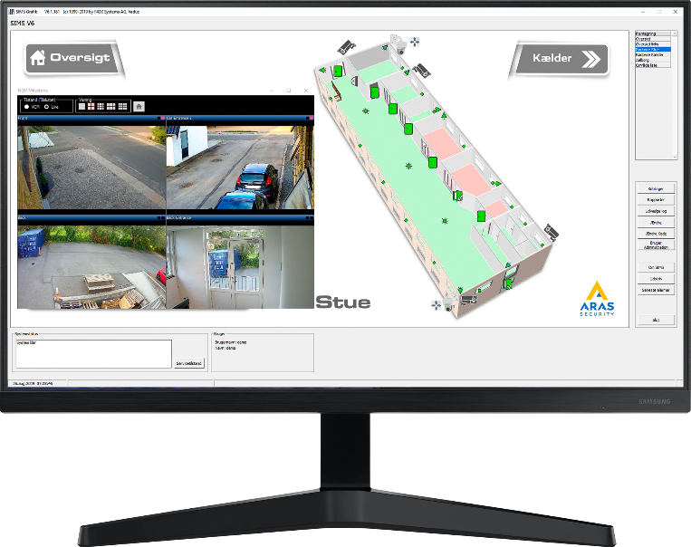
Flexible Control
NOX iOS App
NOX Android App
SIMS
• Smartphones and tablets
• Map and floorplans
• Live-stream from IP-camera
• Push messages when alarm
• Control areas, users, logs and alarms
• Multi-site management system
• Handles +1000 NOX networks
• Map and floorplans
• Live-stream from IP-camera
• Manage integrations
• Control areas, users, logs and alarms

Slide 12
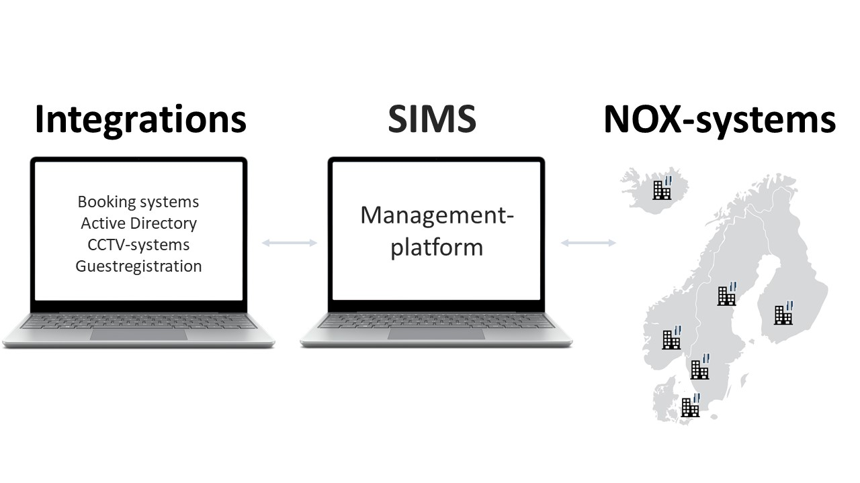
SIMS
Security Information Management System
Graphical interface with dynamic floor plans
Control of multiple NOX networks (+1000)
25 clients can operate the system simultaneously
The Complete Overview
Manages, monitors, connects
and expands your NOX systems
Data stored in SQL database
Area management and access control in all NOX systems
Automatic backup of all NOX central units
Alarm processing, user management and reporting
Log entries limited by SQL Server capacity (SQL Express 1,000,000,000)

Slide 13
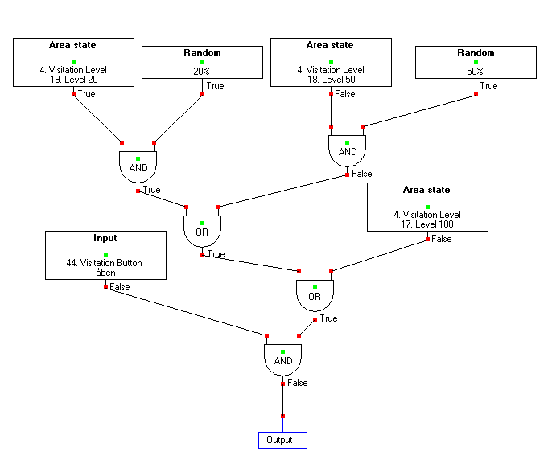
Logical Programming
NOX lets you tailor how all modules
behave based on needed functions.
(…but you don’t have to).
Logical programming gives you the flexibility
to meet all demands from the user.

Slide 14
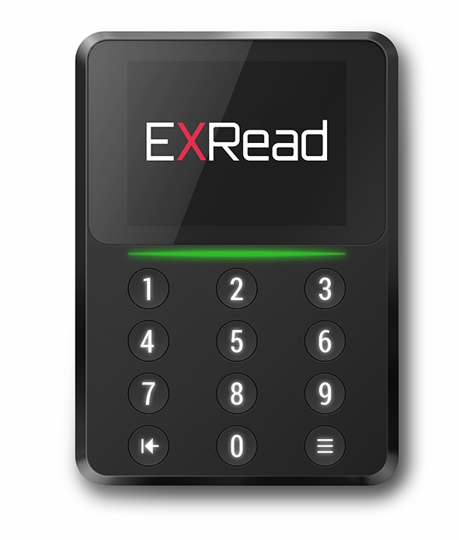
Card Readers
Choose your readers on the global market
OSDP interface
Connects to a NOX CMO module.
Encrypted communication between reader and card reader module.
Wiegand interface
All readers with Wiegand interface can be connected to a NOX CMU module.
Notes:
Nej

Slide 15
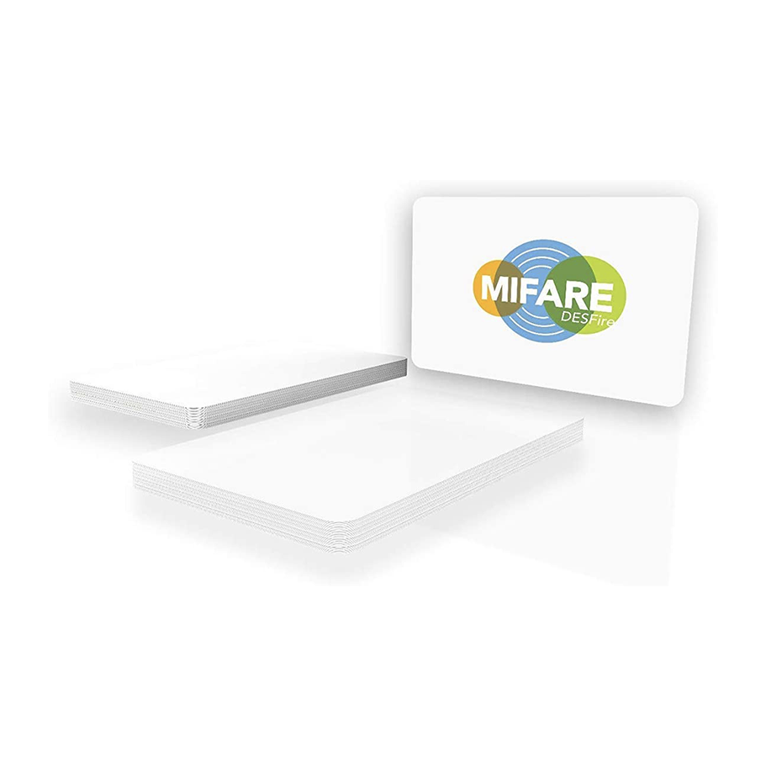
Desfire - Encryption
ARAS Desfire Starter pack
High security without being locked
Use Desfire encryption on cards, without being locked to either manufacturer, distributor or installer.
ARAS Security creates a new Desfire configuration and then provides all information to the end customer.
The customer himself can assign authorizations (keys) for internal/external card production and for the configuration of card readers that are locked to the customer's card.

Slide 16
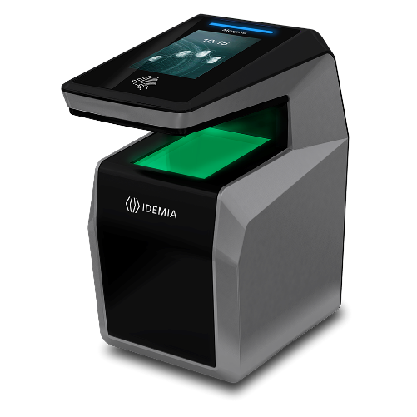
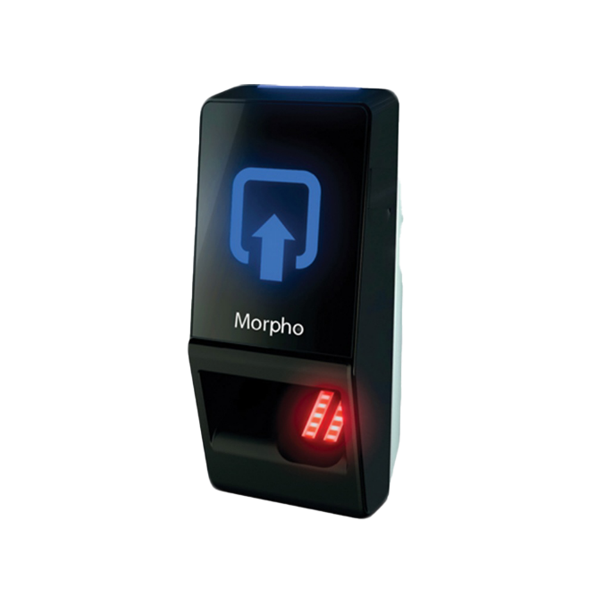
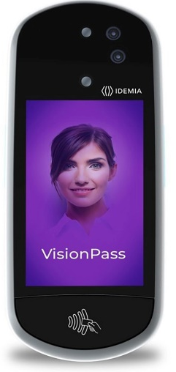
Biometric Readers
Access through the body’s own biometric data
Contactless 3D fingerprint scan
With a quick "swipe", 4 fingers are scanned in 3D.
Fingerprint scan
Combine with access card and/or PIN code.
Facial recognition
Combines 2D, 3D and infrared cameras.

Slide 17
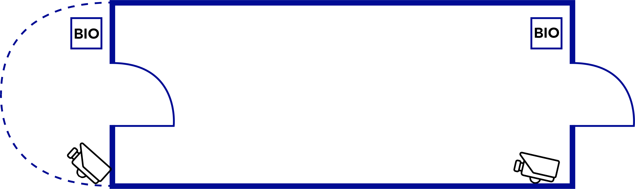
Access Gates
Possibility of Duress Code
Use different access code to alert of danger.
Dual-user confirmation
Access granted only if two users are identified.
CCTV AI for person counting
Verify number of persons entering/exiting.
Multi-factor identification
Use PIN-code and/or access card in combination with biometric data.

Slide 18
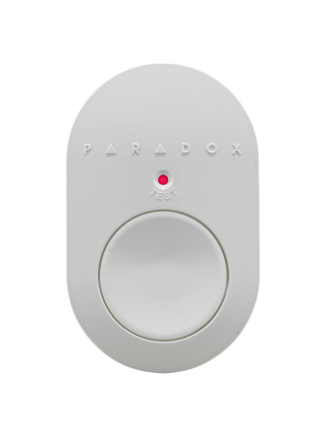
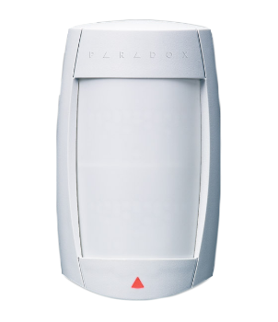
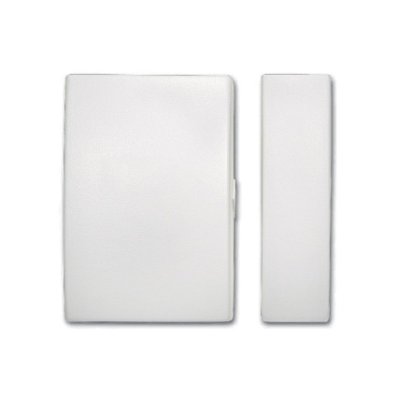
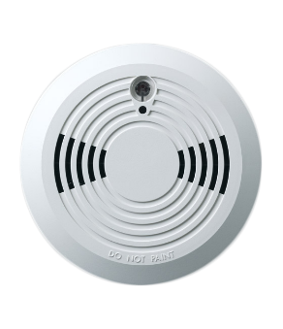
Wireless Detectors
Wireless detectors
Receiver module connects to the NOX Bus
PIR motion detectors
Smoke sensors
Emergency button
Magnetic contacts
Acoustic glass break detectors
…and many more.

Slide 19

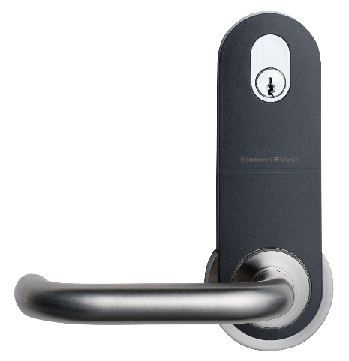
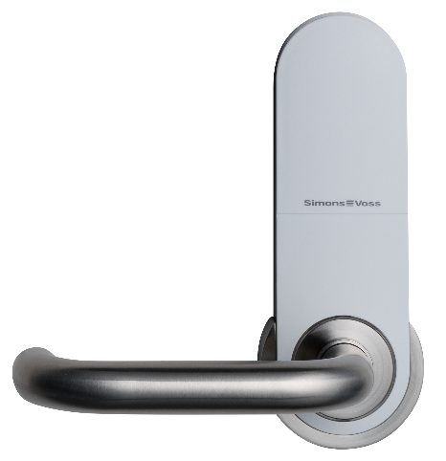
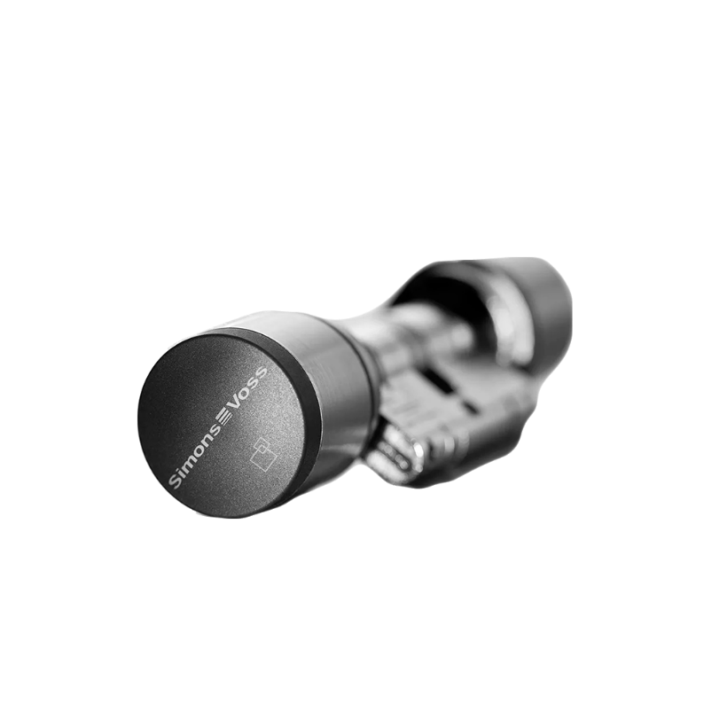
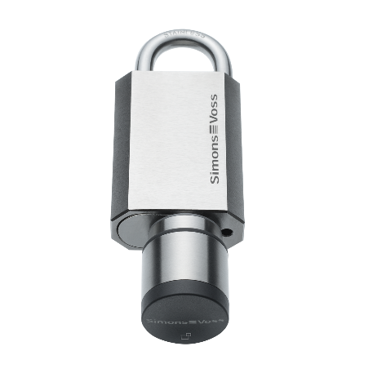
Wireless Card Readers
Wireless doors with card readers
Online/Offline
Door handles
Cylinders
Padlocks
Cabinet locks

Slide 20

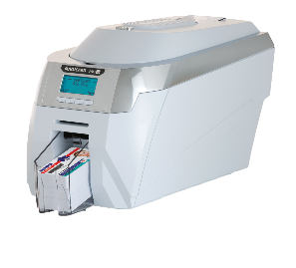
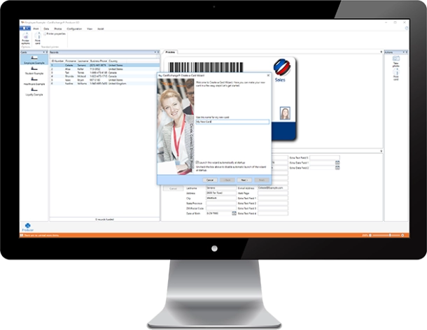
ID-card Print
NOX-integration with CardExchange
Easy ID-card production with CardExchange integration.

Slide 21
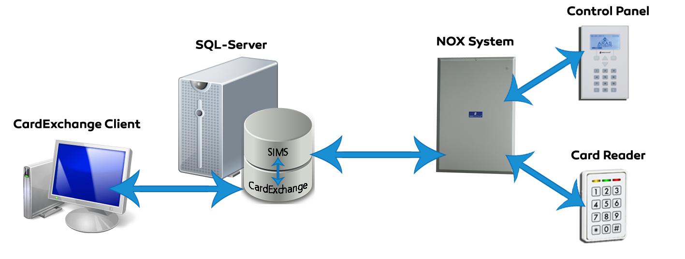
ID-card Print with AD
NOX-integration with CardExchange
Possible setups:
A user in Active Directory gets a card printed,
and is added automatically in the SIMS database.
Add a user's card number in Active Directory.
Access permissions are automatically transferred to the
SIMS database.

Slide 22
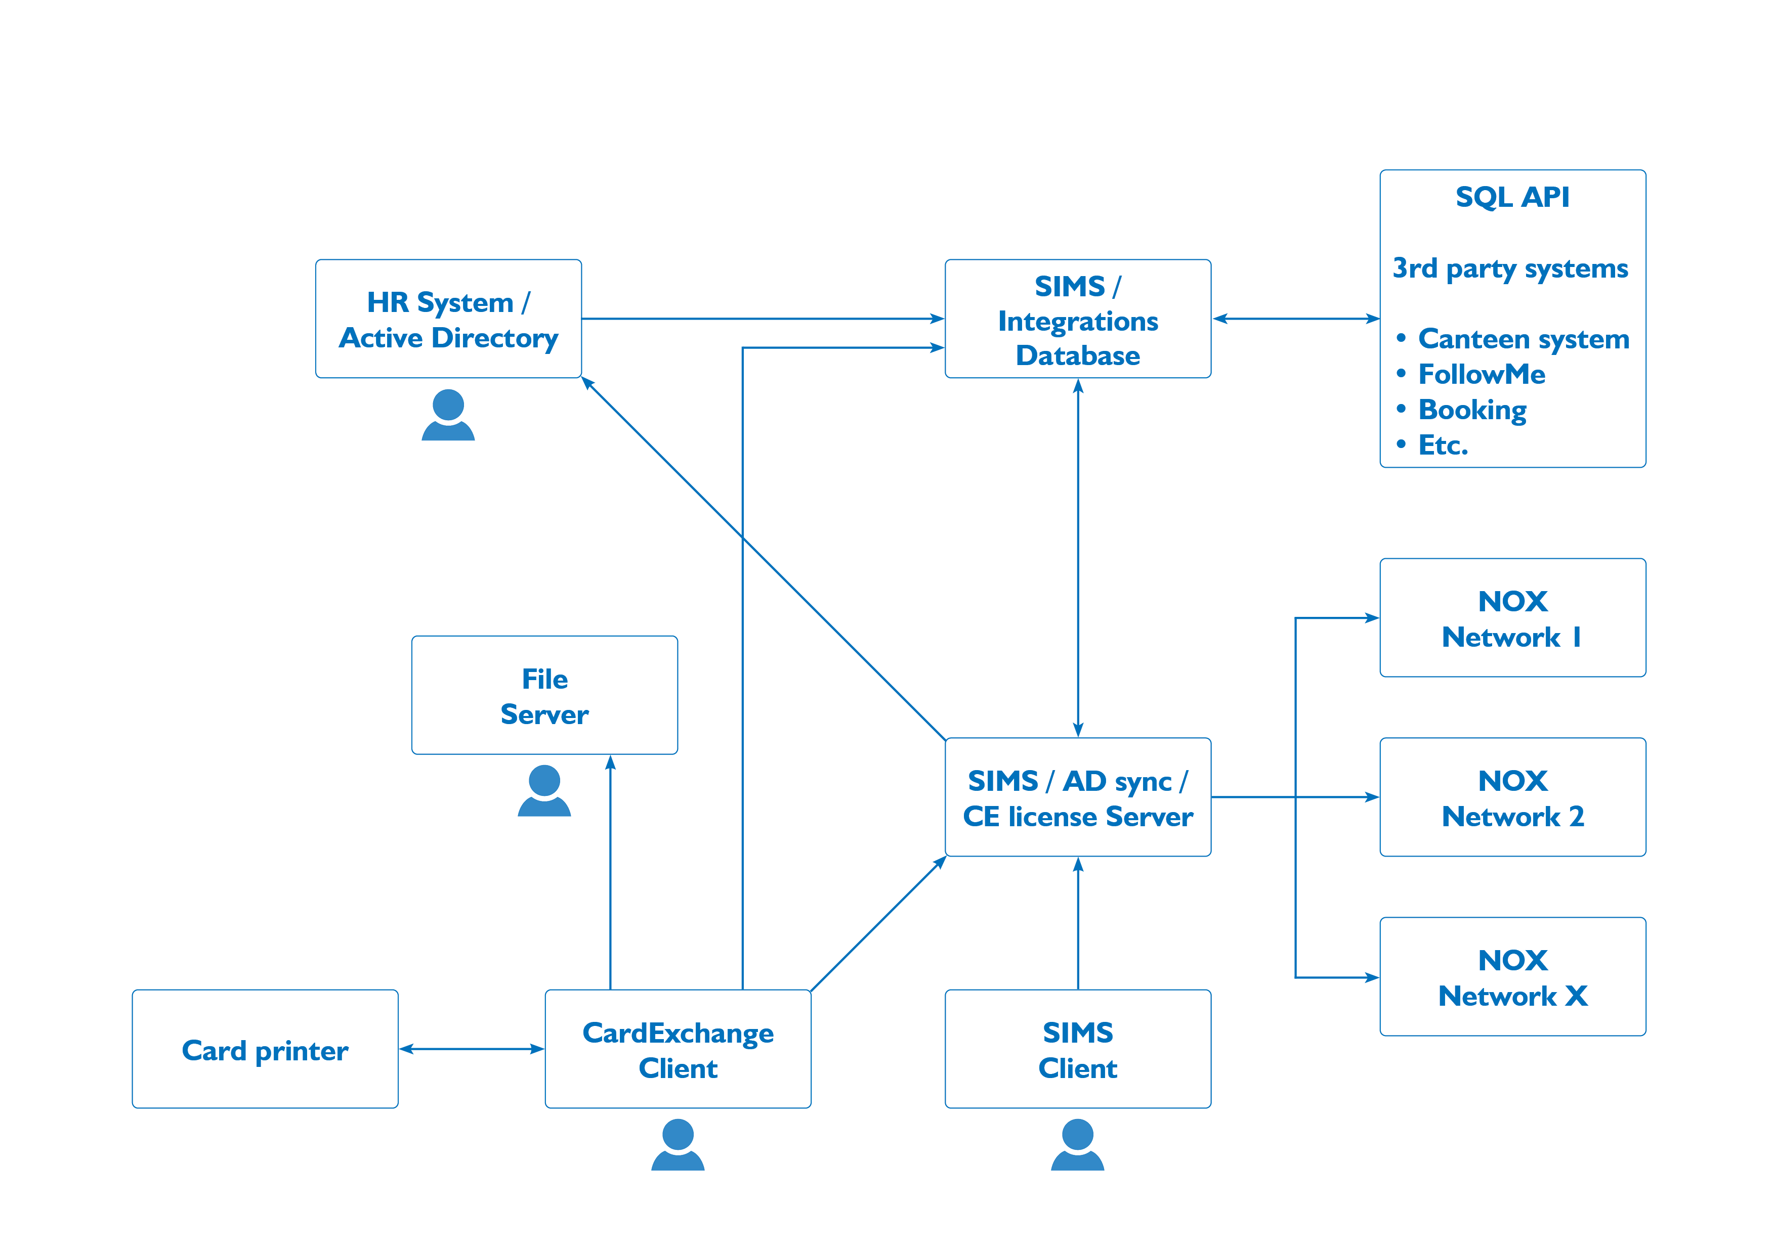
SIMS – AD integrationflow

Slide 23
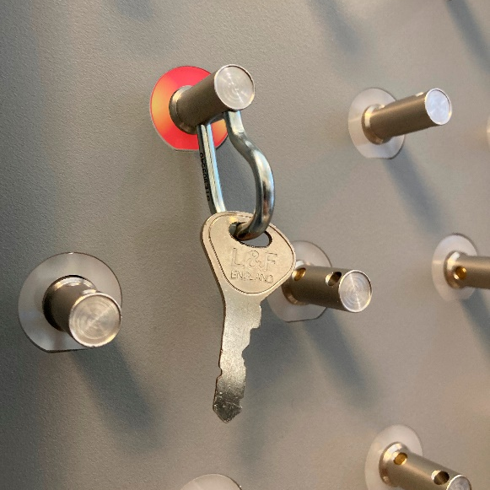
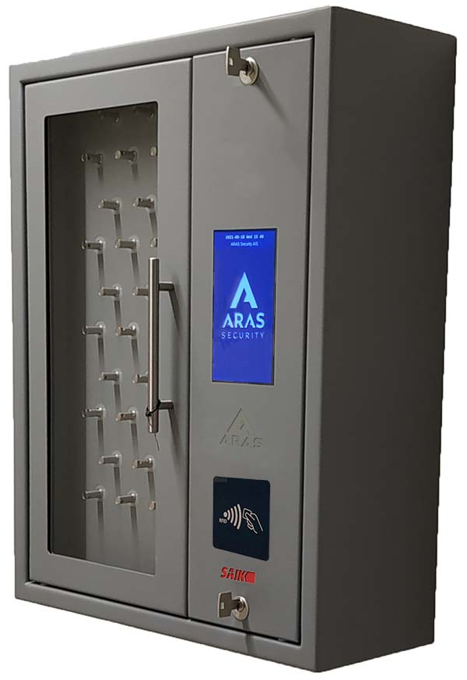
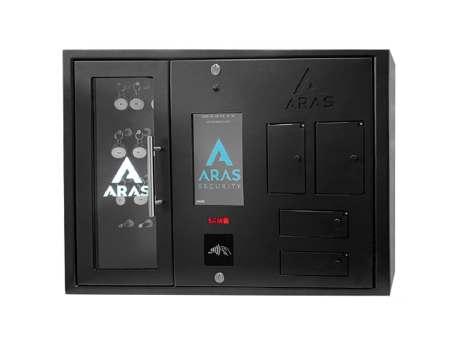
KeyBox
Intelligent Key storage and management
It is possible to combine key lockers
with boxes for storing valuables.
Integrated with NOX.
Available in every size and color.

Slide 24






Integrations
Some of the completed NOX integrations
BOOKING

Slide 25





CCTV
NOX is integrated with several CCTV-protocols
CCTV integrations are made through IP-connection.
LIVE IP Streaming

Slide 26






In-House Development
ARAS develops applications for NOX
Based on the needs of the end-users.

Slide 27

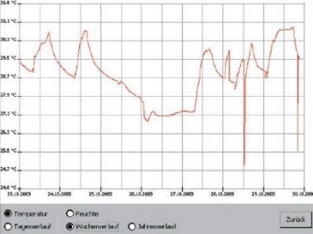
Optimize Energy Use
Intelligent building management
Automatic measurement and registering.
Lighting
Temperature
Humidity
Adapt usage of lighting, ventilation and heating
to time and presence.

Slide 28




NOX is also for…
NOX is approved and registered as a
EN-50131 Class 3 combined security
system in Scandinavia and Europe:
Germany VdS: EN-ST-000185
Denmark F&P: 10.212-11305
Norway FG: SA-1172/22
Sweden SBSC: 14-376
(Larmklass 3 – Miljöklass II)
Housing
…every sector
Retail
Finance
Defense
Government
Logistics
Service
Culture
Construction
Education
Healthcare
Security

